Slide 1

PADMASHRI VIKHE PATIL COLLEGE OF ART'S SCIENCE & COMMERCE,LONI
TOPIC:- Preparation of Biofertilizer.
Presented by:-
Gagare Aditi Kailas

Slide 2
INTRODUCTION:-
A substance containing living microorganisms that enhance soil fertility by fixing atmospheric nitrogen, solubilizing phosphorus, or decomposing organic matter.
Includes Azotobacter, Rhizobium, Azospirillum (for nitrogen fixation), Phosphate-solubilizing bacteria (PSB), and Potassium-solubilizing bacteria (KSB).
AIM :- Production of biofertilizer from the isolated bacteria in soil sample .
OBJECTIVE:-
Preparation of biofertilizer
-Comparative study of biofertilizer and chemical fertilizer .

Slide 3
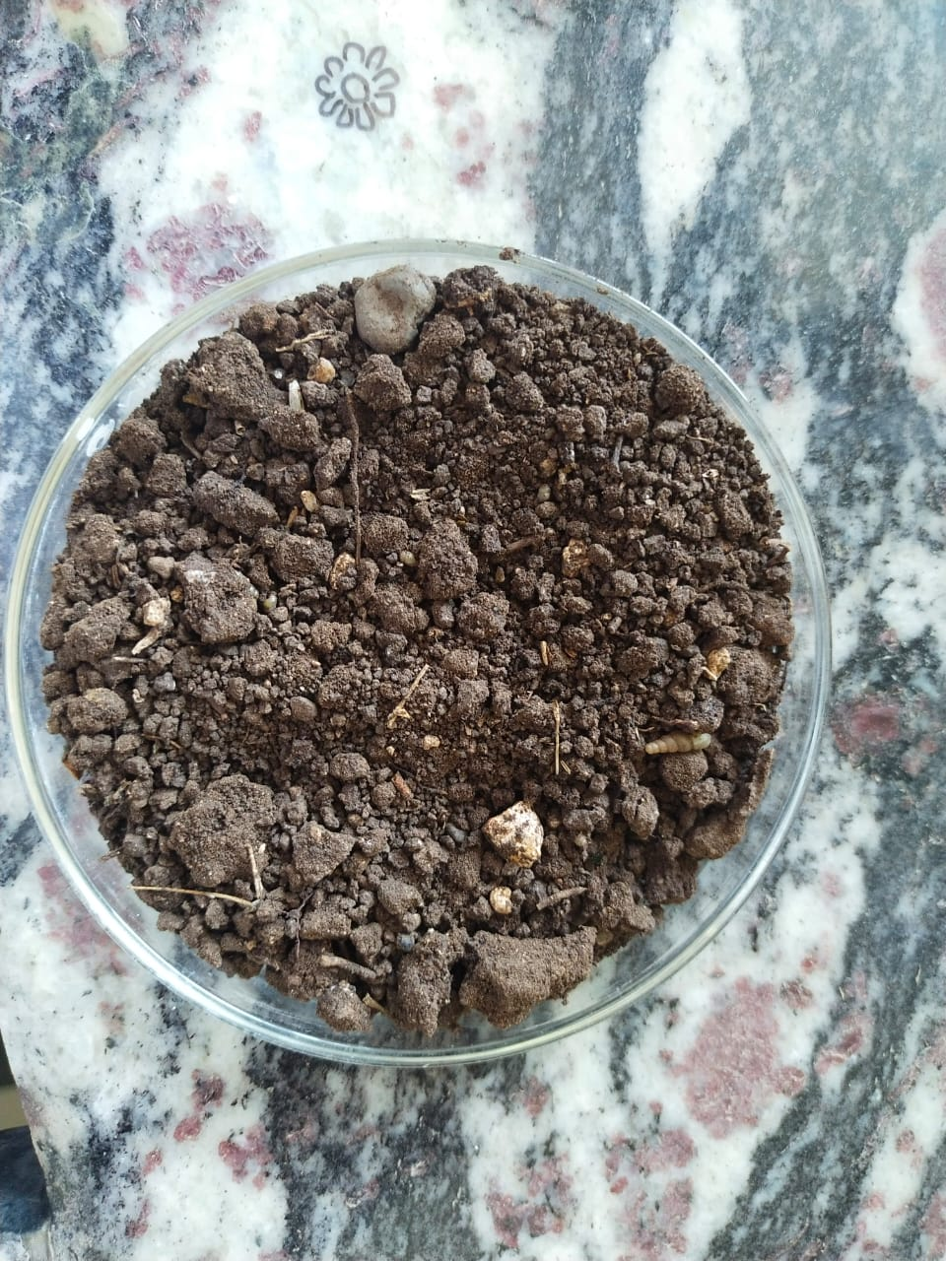
MATERIAL AND METHODS:-
1]Soil sample
2]Ashby’s agar
3]Ashby’s broth
4]Calcium carbonate
5]Charcoal powder
6]Urea

Slide 4
METHODOLOGY:-
Take a soil sample
Inoculate soil sample in Ashby’s broth and keep it 3-4 days for incubation .
Inoculate loopfull culture on Ashby’s agar plate and incubate for 2-3 days.
Choose a mucoid colony and perform biochemical test.
After biochemical test , colony detected as Azatobacter spp.

Slide 5
Preparation of bioinoculant from the detected colony sample and ratio used as 1: 2: 1 of an unsterile soil , charcoal powder and CaCO3( Calcium Carbonate) in proportion.
Add 1ml of bacterial suspension in per gram of unsterile soil.
Maintain the moisture by keeping it, in dark for 2-3 days.
Biofertilizer is ready to use.
Check its activity against chemical fertilizer (Urea).

Slide 6
MORPHOLOGY:-
CHARACTERS | RESULT
Shape | Circular
Size | 1.5 – 2.0 mm
Color | Milky white
Elevation | Flat
Consistency | Mucoid
Opacity | Opaque
Gram’s Nature | Gram +ve

Slide 7
BIOCHEMICAL CHARACTERISATION (IMViC) :-
TEST | RESULT
Indole | +ve
Methyl Red | +ve
Voge’s Proskauer | +ve
Urease | +ve
Citrate | -ve
Catalase | -ve

Slide 8
COMPARISON:-
BIOFERTILIZER v/s CHEMICAL FERTILIZER

Slide 9
REFERENCES:-

Slide 10
THANKYOU

